Slide 1
Environment Setting
Deep Learning Algorithms
Ph.D. Junetae, Kim
Assistant professor

Slide 2
Contents
Installing Anaconda
Installing Jupyter lab
Introduction to tensorflow and keras
Installing Tensorflow
https://www.anaconda.com/open-source

Slide 3
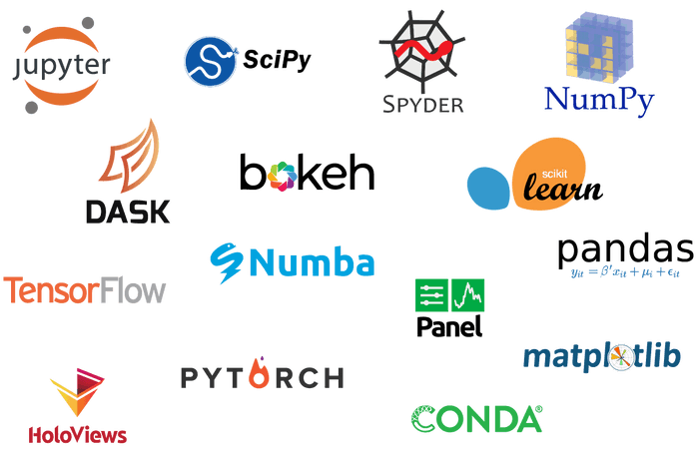
What is anaconda?
A set of packages for data science including Python
https://www.anaconda.com/open-source

Slide 4
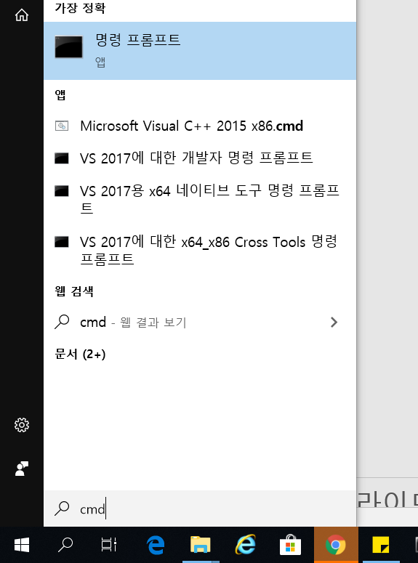
1. Installing Anaconda
(1) Checking computer ‘bit’ information
①Click the lower-left Start button to open the Start Menu,
②input cmd in the empty box and tap Command Prompt in the results.

Slide 5
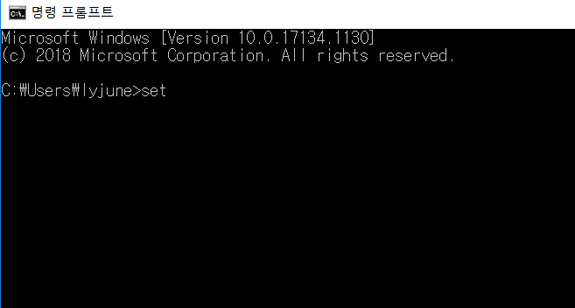
1. Installing Anaconda
(1) Checking computer ‘bit’ information
③ input set and press enter key

Slide 6
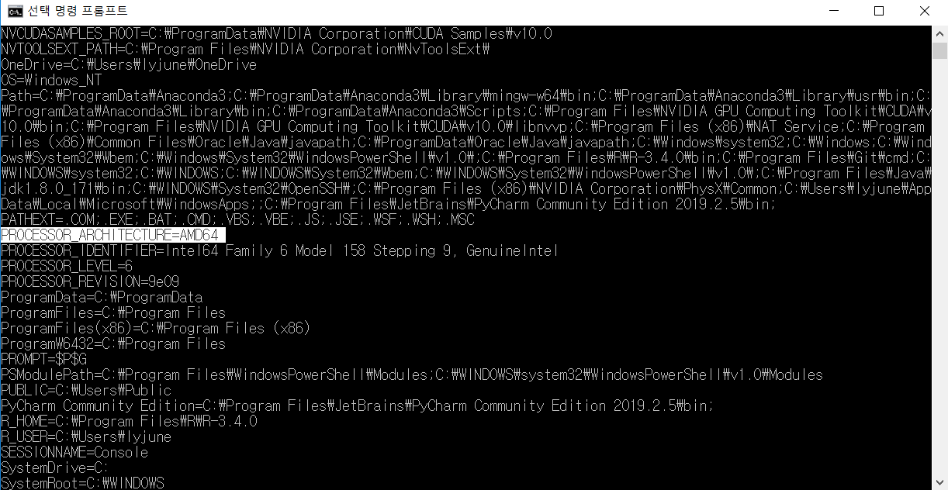
1. Installing Anaconda
(1) Checking computer ‘bit’ information
④ Check PROCESSOR_ARCHITECTURE=??

Slide 7

1. Installing Anaconda
(2) Downloading the anaconda installer
Input anaconda in Google search box.
Open the Web page - https://www.anaconda.com/

Slide 8

1. Installing Anaconda
(2) Downloading the anaconda installer

Slide 9

1. Installing Anaconda
(2) Downloading the anaconda installer
Click Get Started

Slide 10

1. Installing Anaconda
(2) Downloading the anaconda installer
You nee to sign up and sign in

Slide 11
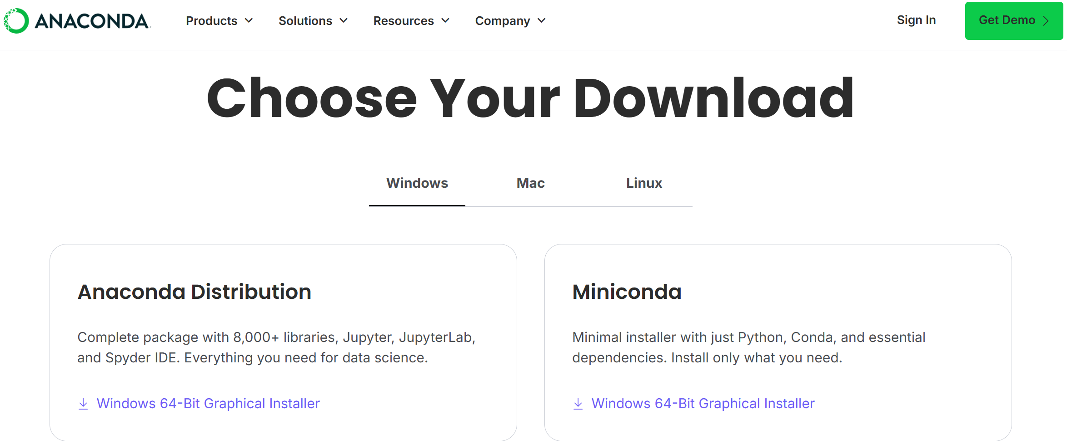
1. Installing Anaconda
(2) Downloading the python installer
Downloading Windows installer (64-bit) (pc bit version ==64)

Slide 12
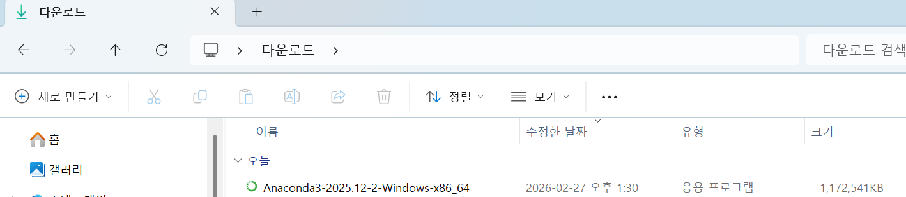
1. Installing Anaconda
(2) Installation
Execute the install file

Slide 13
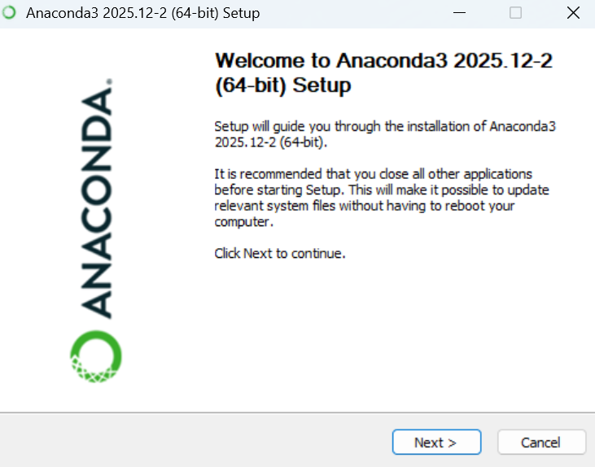
1. Installing Anaconda
(3) Installation

Slide 14
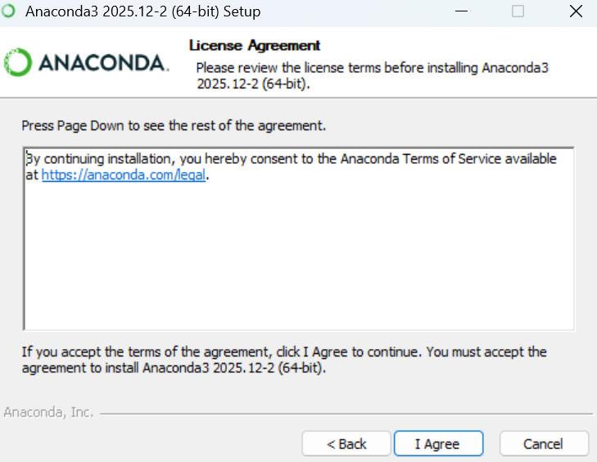
1. Installing Anaconda
(3) Installation

Slide 15
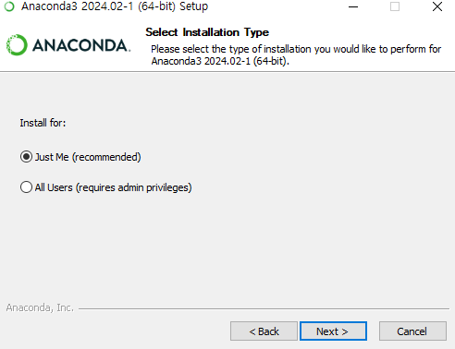
1. Installing Anaconda
(3) Installation

Slide 16
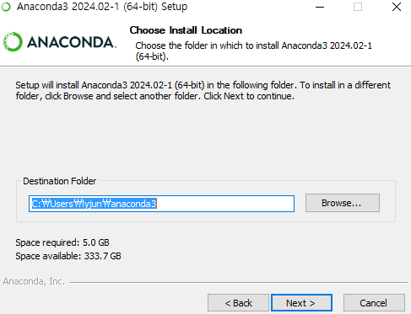
1. Installing Anaconda
(3) Installation

Slide 17
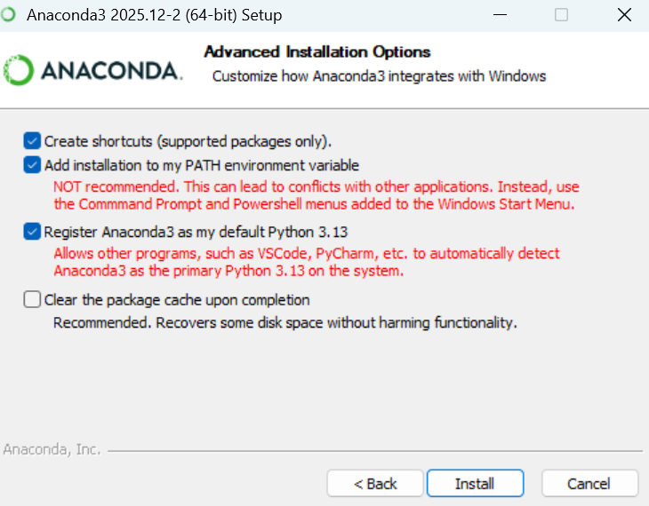
1. Installing Anaconda
(3) Installation

Slide 18
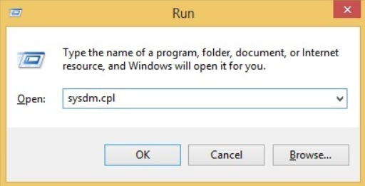
1. Installing Anaconda
(4) Checking whether Python is working or not
start the Run box and enter sysdm.cpl

Slide 19
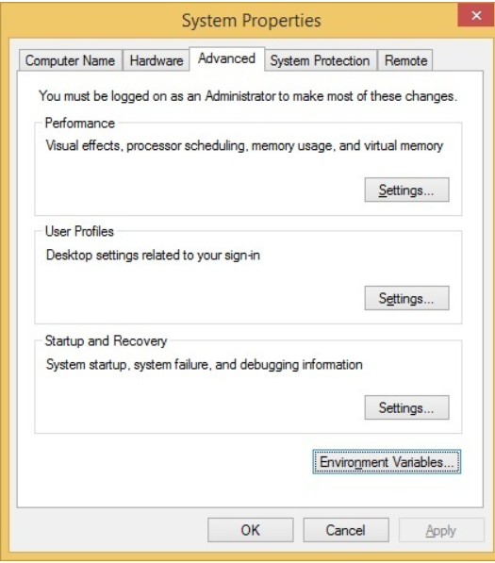
1. Installing Anaconda
(4) Checking whether Python is working or not
Go to the Advanced tab and click the Environment Variables button

Slide 20
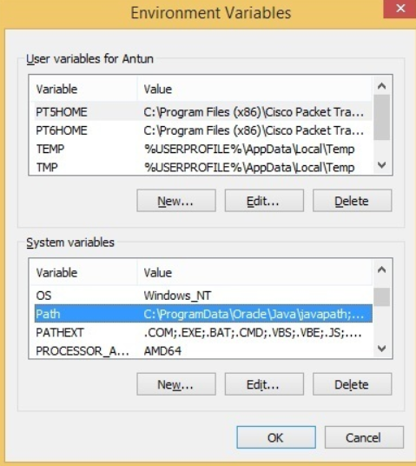
1. Installing Anaconda
(4) Checking whether Python is working or not
In the System variable/ User variables window, find the Path variable and click Edit
Or

Slide 21
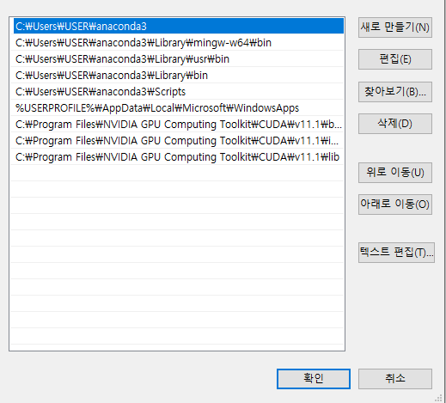
1. Installing Anaconda
(4) Checking whether Python is working or not
Check whether there several lines related to anaconda3

Slide 22
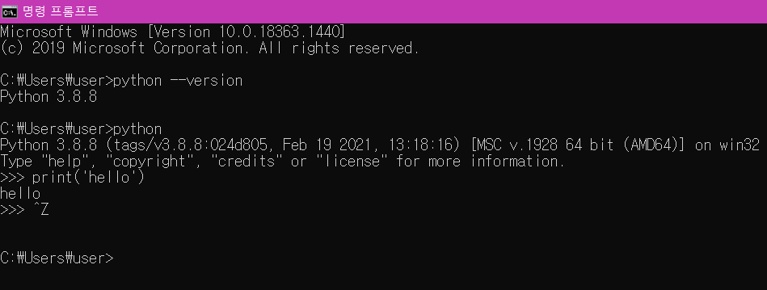
1. Installing Anaconda
(4) Checking whether Python is working or not
Input: python, press enter key
Input: print(‘hello’), press enter key
ctr + z to exit python

Slide 23
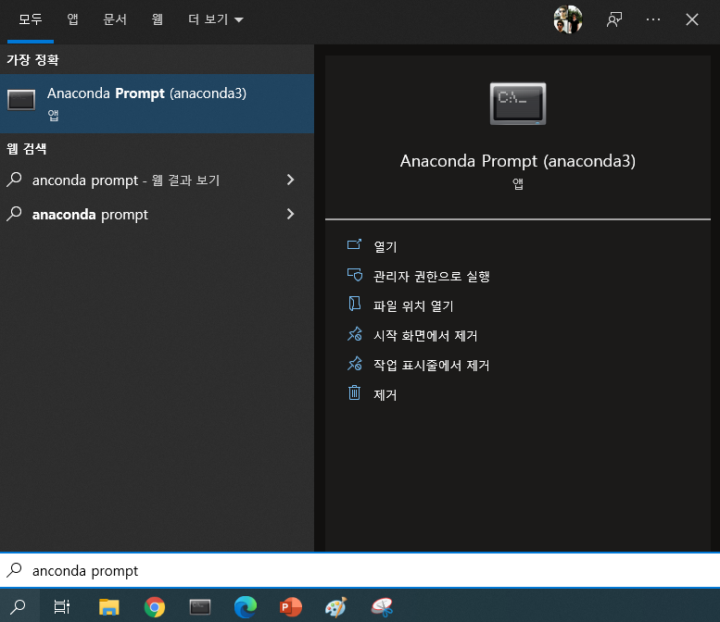
1. Installing Anaconda
(4) Creating virtual environment
Open Anaconda Prompt

Slide 24
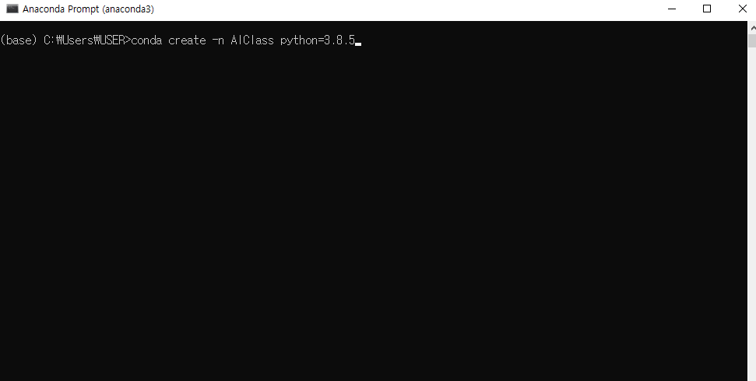
1. Installing Anaconda
(4) Creating virtual environment
Open Anaconda Prompt
Type: conda create -n <my_environment> python=<new_version>
conda create -n AIClass python=3.10

Slide 25
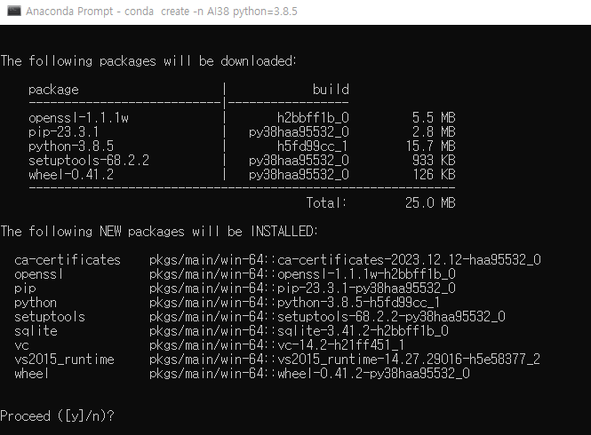
1. Installing Anaconda
(4) Creating virtual environment
Install related packages: Press y and enter key

Slide 26
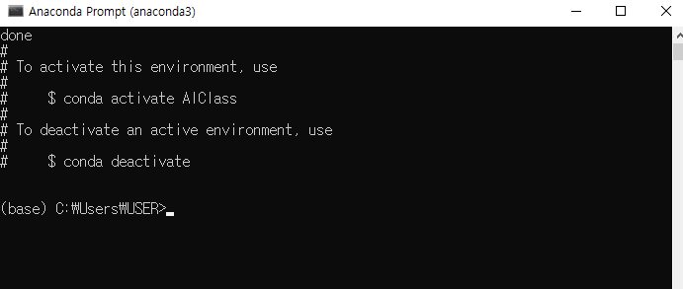
1. Installing Anaconda
(4) Creating virtual environment
Now, you have just created virtual environment named as ‘AIClass’

Slide 27
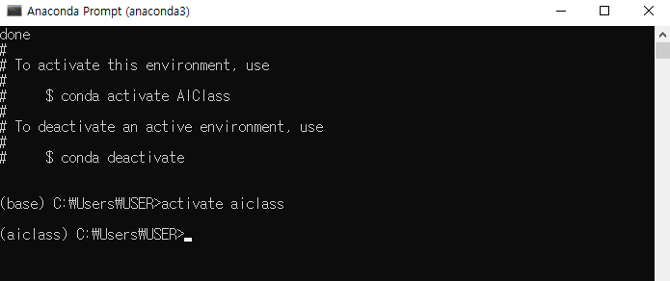
1. Installing Anaconda
(4) Creating virtual environment
You should activate the virtual environment before doing your python task
activate <your environment name>
conda activate AIClass

Slide 28
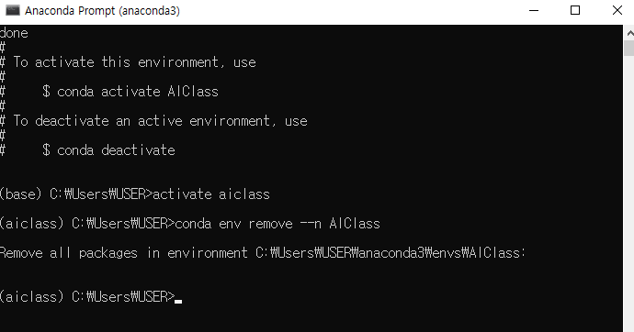
1. Installing Anaconda
(4) Removing virtual environment
Sometime you need to remove your environment for several reasons
conda env remove --n <your environment name>
conda env remove --n AIClass

Slide 29
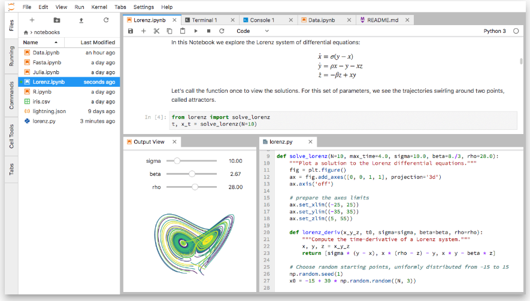
2. Installing Jupyter lab
(2) Jupyter lab installation
What is Jupyter lab?
It’s a convenient tool for python programming
It enables you to work with documents and activities such as Jupyter notebooks, text editors, terminals, and custom components in a flexible, integrated, and extensible manner.

Slide 30
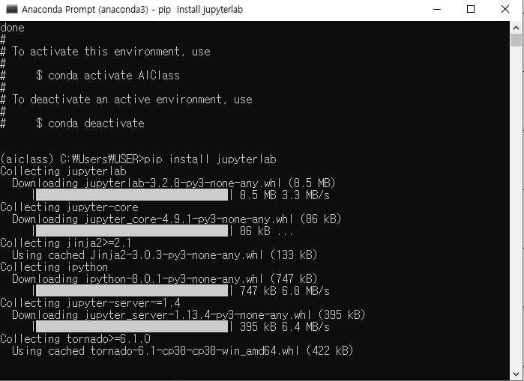
2. Installing Jupyter lab
(2) Jupyter lab installation
Open CMD, activate <your_enviorment >,
then input: pip install jupyterlab (no blank between two words)

Slide 31
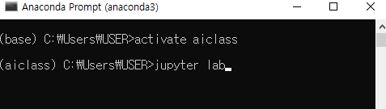
2. Installing Jupyter lab
(4) Run Jupyter lab
Open CMD, activate <your_enviorment >,
then input: jupyter lab (blank between two words!)

Slide 32
2. Installing Jupyter lab
(5) Set the chrome as default
English
https://support.google.com/chrome/answer/95417?co=GENIE.Platform%3DDesktop&hl=en
Korean
https://support.google.com/chrome/answer/95417?co=GENIE.Platform%3DDesktop&hl=ko

Slide 33
Break time

Slide 34
2. Installing Jupyter lab
(6) Introduction to Jupyter lab
②
①
③
Click

Slide 35
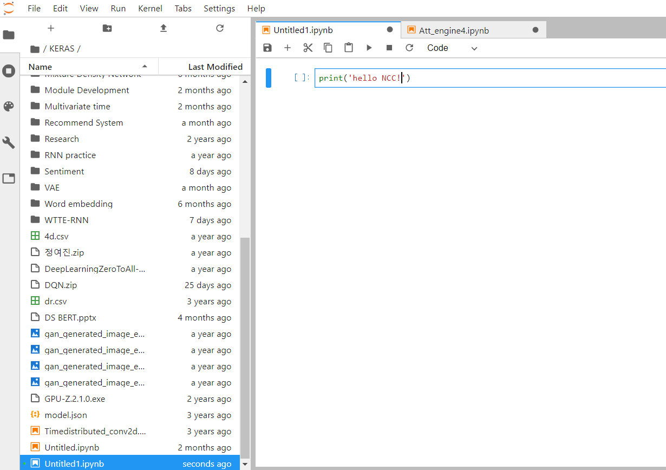
2. Installing Jupyter lab
(6) Introduction to Jupyter lab
Type it, then press ctrl + enter key

Slide 36
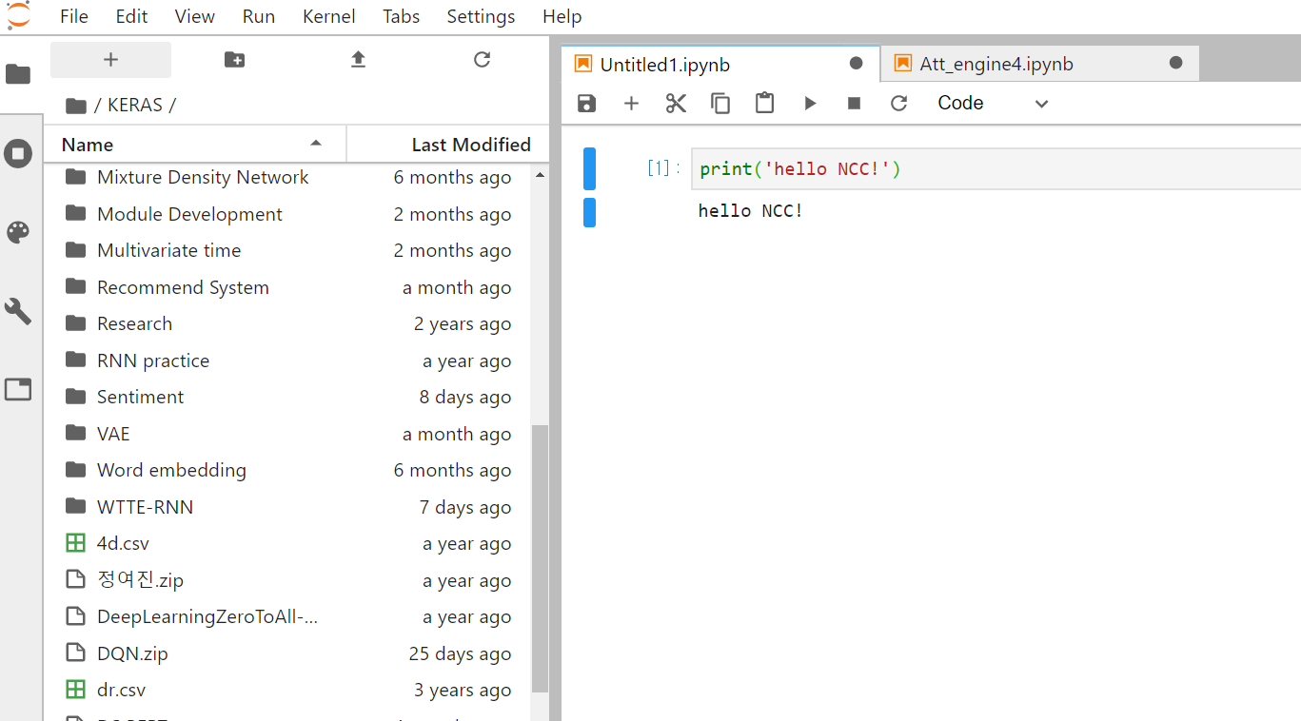
2. Installing Jupyter lab
(6) Introduction to Jupyter lab
Your Input
Return

Slide 37
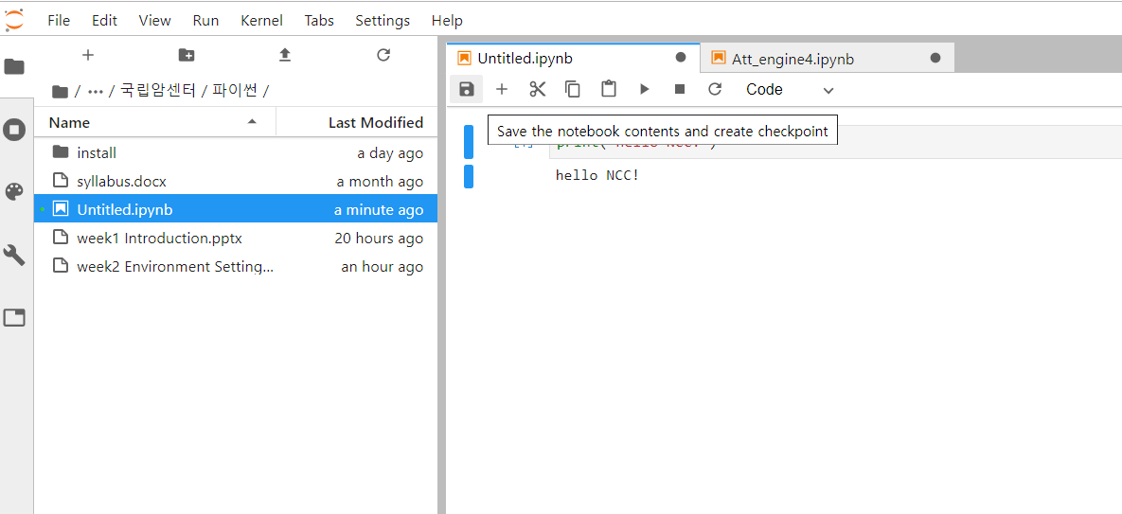
2. Installing Jupyter lab
(6) Introduction to Jupyter lab
Save

Slide 38
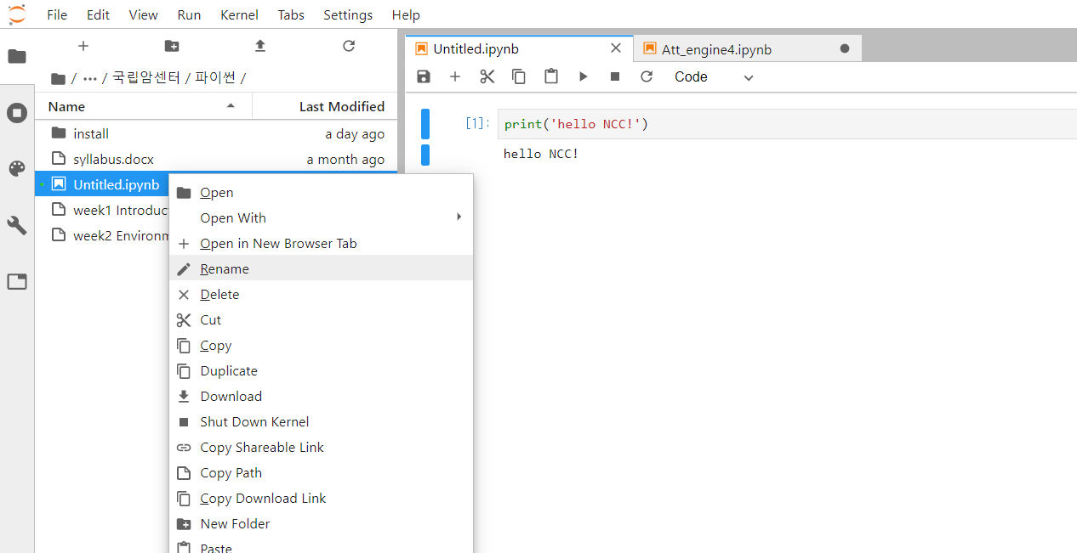
2. Installing Jupyter lab
(6) Introduction to Jupyter lab
Rename

Slide 39
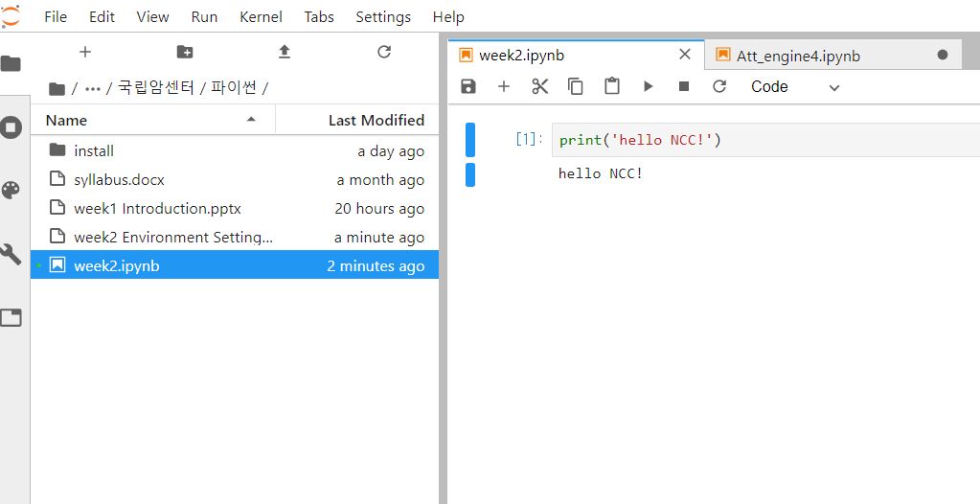
2. Installing Jupyter lab
(6) Introduction to Jupyter lab

Slide 40
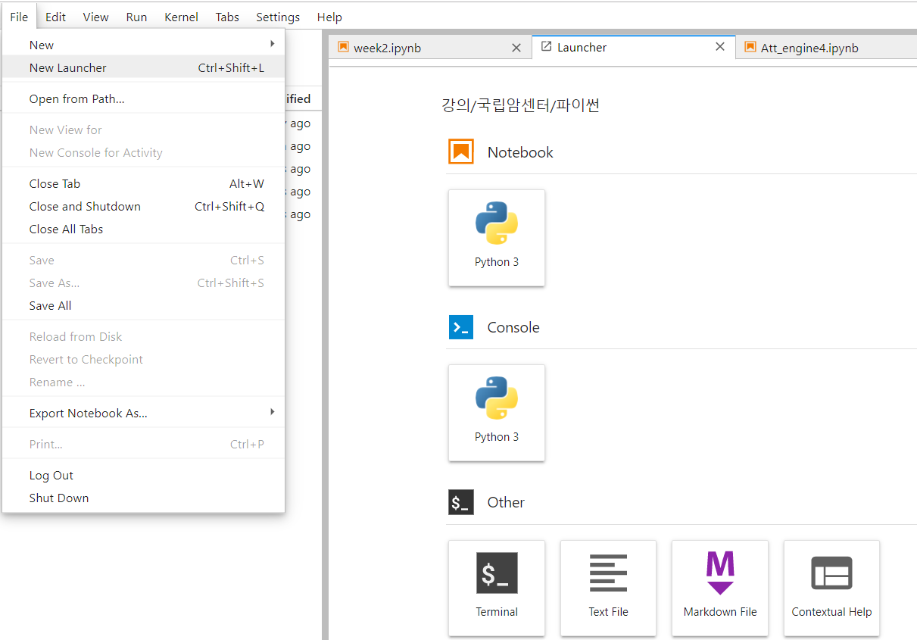
2. Installing Jupyter lab
(6) Introduction to Jupyter lab
①
②

Slide 41
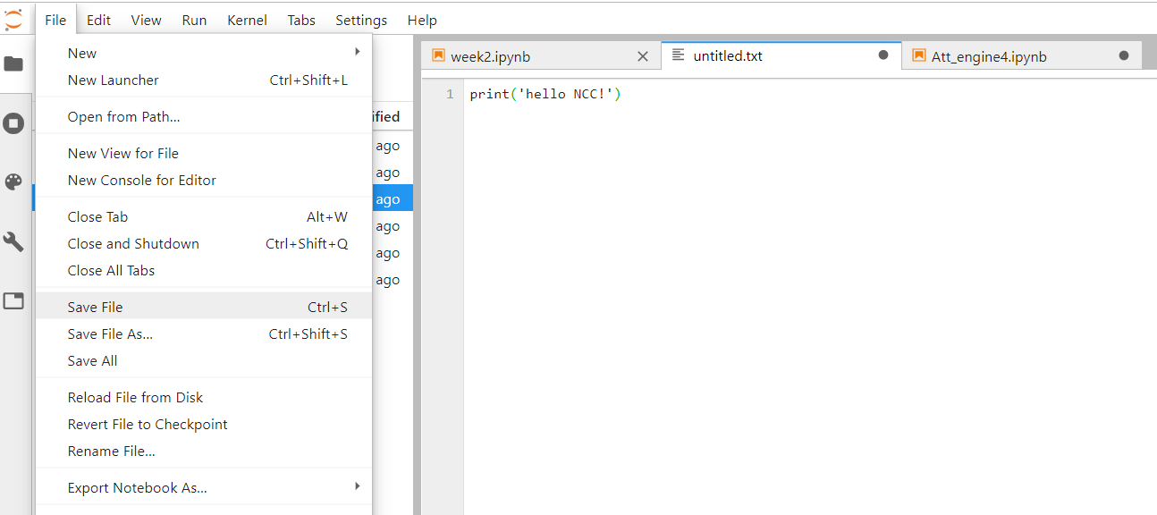
2. Installing Jupyter lab
(6) Introduction to Jupyter lab
① Type
② Save the file

Slide 42
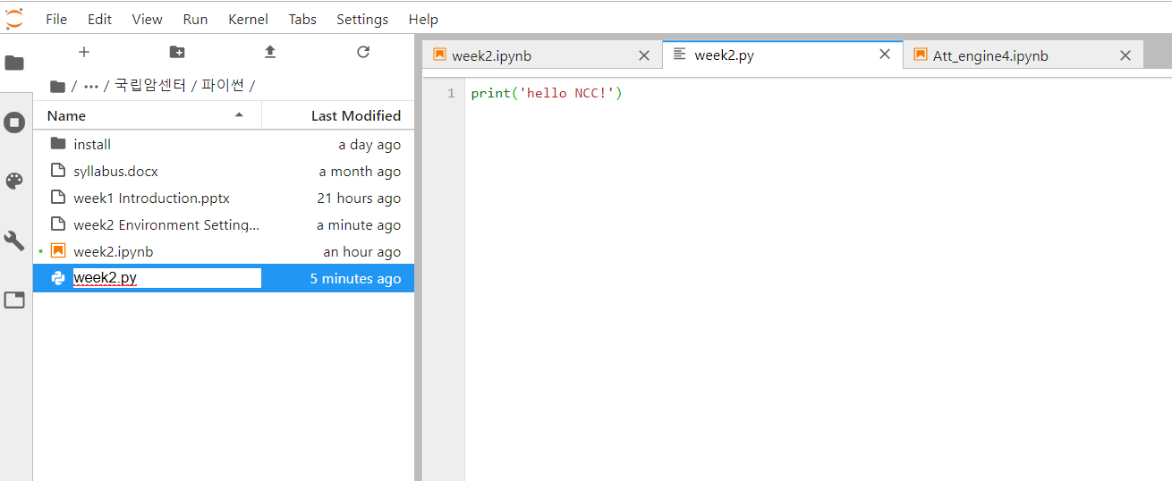
2. Installing Jupyter lab
(6) Introduction to Jupyter lab
Rename the file as ‘week2.py’

Slide 43
2. Installing Jupyter lab
(6) Introduction to Jupyter lab
Open Terminal (CMD window)

Slide 44
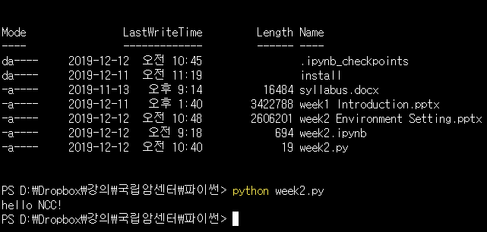
2. Installing Jupyter lab
(6) Introduction to Jupyter lab

Slide 45
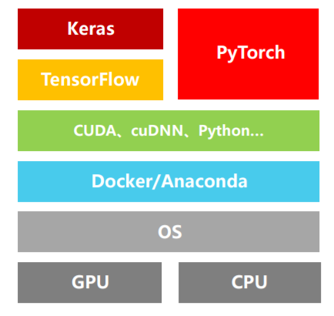
3. Understanding tensorflow and keras
Keras vs tensorflow
https://blog.csdn.net/zhr1030635594/article/details/104621957

Slide 46
3. Understanding tensorflow and keras
Keras vs tensorflow
Parameters | Keras | TensorFlow
Developed By | Francois Chollet | Google Brain Team
Definition | Keras is a high-level neural network library that executes on top of TensorFlow | TensorFlow is a comprehensive open-source framework for multiple machine learning tasks
Architecture | High-level architecture API and simple architecture, readable and concise | Low-level architecture API and complex architecture
Written In | Python | C++, Python, CUDA
Ease of Use | More user friendly and easy to use | Not as easy to use as Keras
Functionalities | General-purpose operations to create deep learning models | Advanced functionalities for creating neural networks
Debugging | Easier to debug | Difficult to debug
Data Sets | It has smaller data sets | It has larger data sets
https://www.spec-india.com/blog/keras-vs-tensorflow

Slide 47
3. Understanding tensorflow and keras
Keras vs tensorflow
Parameters | Keras | TensorFlow
Complexity | Facilitates model development with ease and makes it comfortable | Users need to handle computations making it complex
Development Time | Fewer lines of code, faster development time | Development time is more since more coding involved
Performance | Based on backend engines and hence slow in performance | Has a focus on lessening cognitive computational load hence faster performance
Debugging Capacity | Keras has lesser backend computation and debugging the code is easier | There is code involved and hence debugging is done through the TensorFlow debugger
Trained Models | Keras has trained models | TensorFlow has trained models
Best For | Quick implementations, rapid prototyping, multiple backend support | Deep learning and complicated tasks, high performance, object detection, functionality
Community Support | Less but growing community support | Large community support
Popularity | Keras tops the popularity chart | TensorFlow follows Keras on the popularity chart
User Friendliness | Keras in novice-friendly | TensorFlow is tough for novices

Slide 48
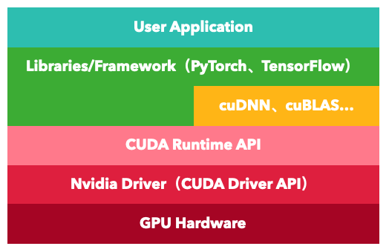
3. Understanding tensorflow and keras
Understanding middlewares when GPUs are used
CUDA
It ensures that the compiler is directed to the part that matches the GPU core. It makes the processing unit efficient for the operation to be performed
https://zhuanlan.zhihu.com/p/342003923

Slide 49
3. Understanding tensorflow and keras
Understanding middlewares when GPUs are used
cuDNN
It provides a performance boost when training a neural network with a GPU.
https://zhuanlan.zhihu.com/p/342003923

Slide 50
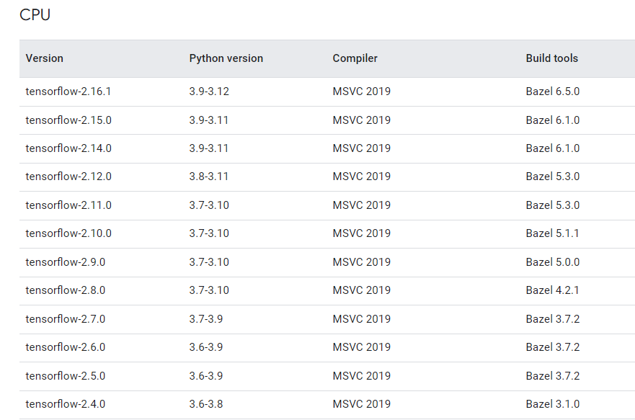
4. Installing Tensorflow
(1) Compatibility check
https://www.tensorflow.org/install/source_windows

Slide 51
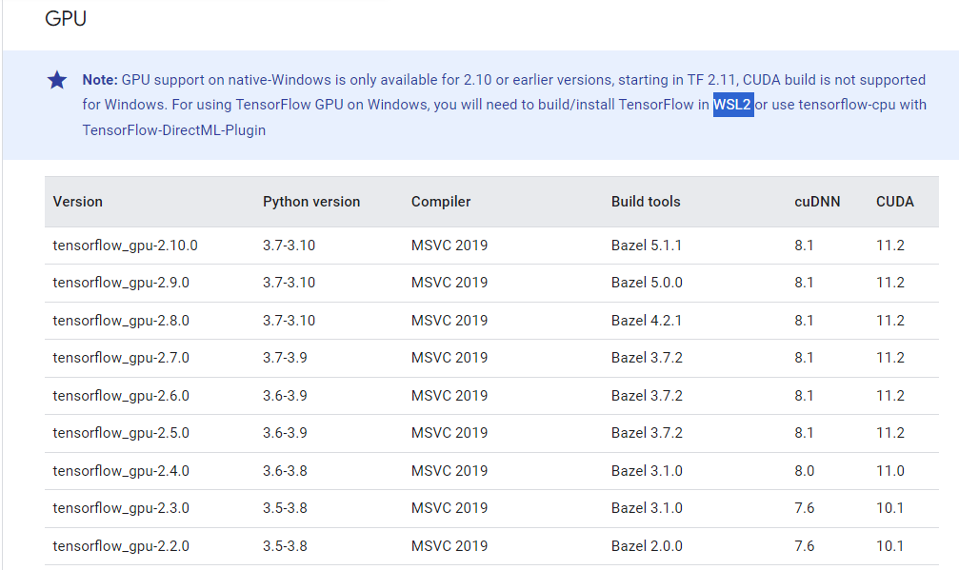
4. Installing Tensorflow
(1) Compatibility check
https://www.tensorflow.org/install/source_windows

Slide 52
4. Installing Tensorflow
(2) Activating virtual environment
You should activate the virtual environment before installing tensorflow
activate <your environment name>
Activate AIClass

Slide 53
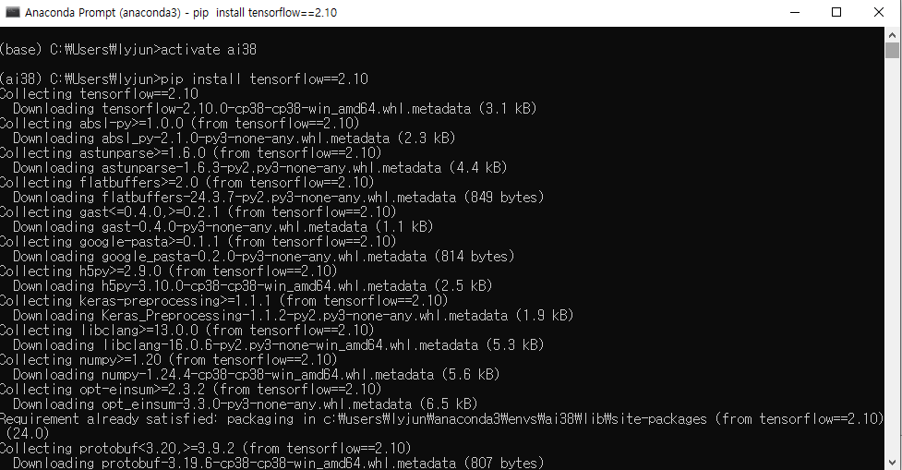
4. Installing Tensorflow
(3) Installing tensorflow via pip install
pip install tensorflow==2.10

Slide 54
1. Installing Anaconda
(4) Other library installations
pip install numpy==1.25.0 pandas==2.2.3 matplotlib==3.9.2 seaborn==0.13.2 scipy==1.13.1 scikit-learn==1.5.2

Slide 55
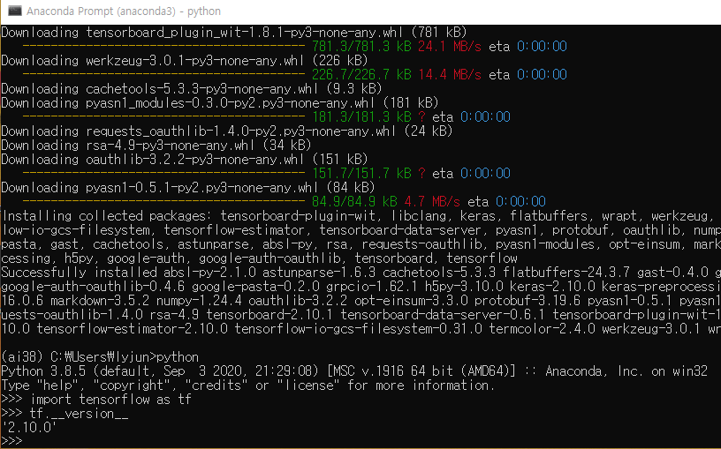
4. Installing Tensorflow
(5) Check if tensorflow is installed properly, and which version is installed
python
import tensorflow as tf
tf.__version__

Slide 56
5. Google drive & github
Google driver
https://drive.google.com/drive
Github
https://github.com/
https://github.com/JunetaeKim/DeepLearningClass

Slide 57
6. Colab
Google colab
https://colab.research.google.com/github/JunetaeKim/DeepLearningClass/blob/main/Week2/TfTest.ipynb

Slide 58
Assignment presentation

